Slide 2
Elsebeth Pedersen
Denmark

Slide 3
Findings of the project
It is not meaningful to list good and bad technologies, but to identify good or bad use of any technology
Before assessing or deciding any use of technology, the teacher must define the learning outcome that he wants for his students
When introducing technology the teacher must consider, how´he can keep an eye on the students’ learning proces and reveal misconceptions
The considerations that the teacher must do when introducing digital technologies are the same as for teaching in general

Slide 4
Two ways of using geogebra – red or green
Topic: The area of rectangles
Expected learning outcome: The students know that the area of a rectangle is found by multiplying the two sides.
Area = Length * hight
Exercise: Find the area of the following rectangles:
a = 7 and b = 10
a = 11 and b=6
………

Slide 5
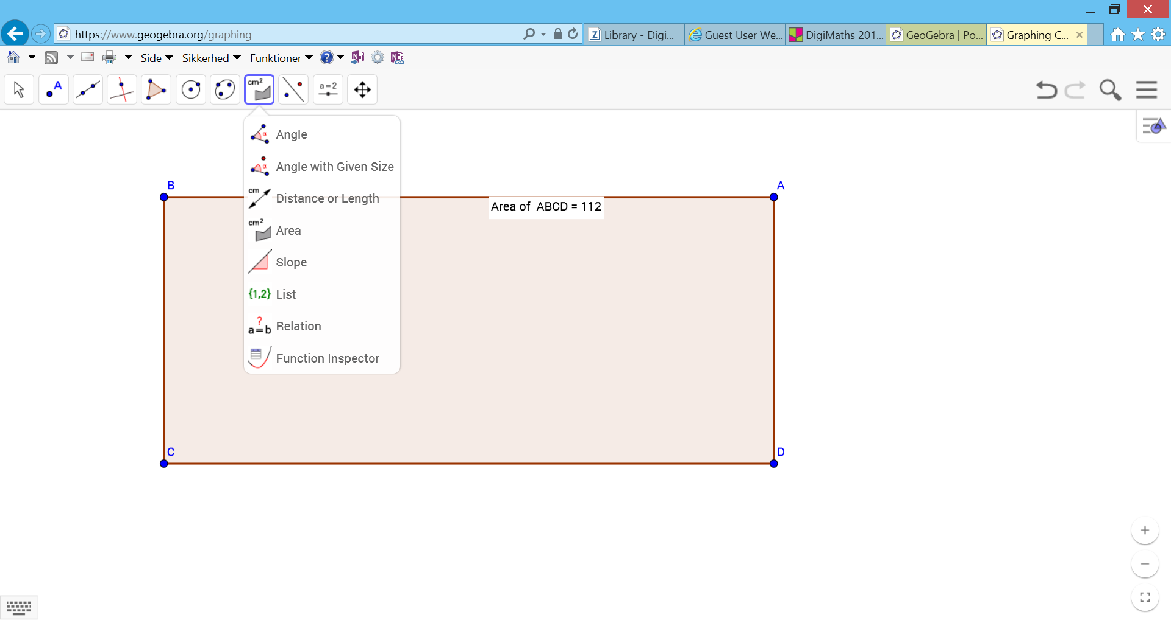
Finding the area of a square
Geogebra
7
16

Slide 6
Learning by Dialogue
Exercise:
Work together in pairs.
Watch the Geogebra movie on the link below. The movie is about finding the area of a rectangel. The movie is silent. While watching the movie one of you must explain to the other what goes on in the movie. You may have pauses and discuss, if necessary.
Conclude the rule: How do you find the area of a rectangle?
Is there any difference whether the rectangle is tall and narrow or flat and wide?
Geogebra film about areas

Slide 7
From deduction to induction
Deduction:
When the teacher tells from the blackboard how to, and the students practice to get routine and to remember
Induction
When the students explore, investigate and conclude and deduce the mathematical rules

Slide 8
Learning by investigation
Exercise:
Draw a rectangle in Geogebra.
Observe the area and the circumference
Try to change the rectangle without changing the circumference
What happens with the area
What is the largest area, that you can achieve?
Can you identify the connection between the side relations and the area?
The connection between area and circumference

Slide 9
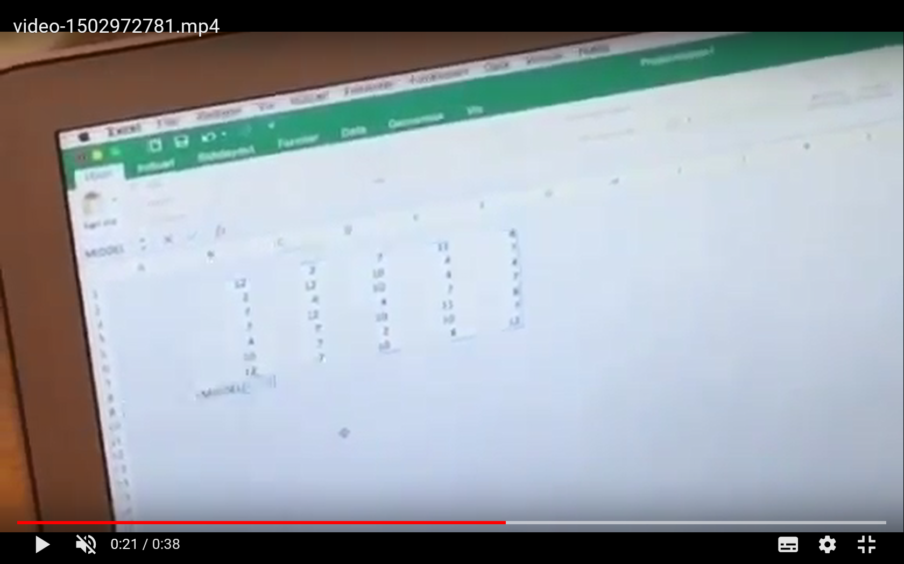
Pupils reflecting on their use of technology

Slide 10
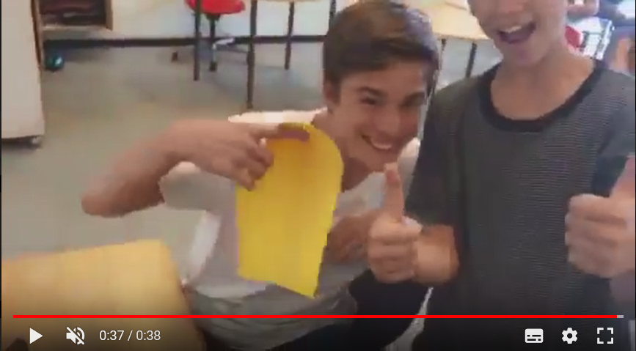
Boys assessing spreadsheet session yellow

Slide 11
What did the teacher want the students to learn from this acitivity ?
Nothing new, just letting the students use the spreadsheet to do the calculation instead of a calculator ?
To understand the concept ”average” ?
To learn how to use the spreadsheet ?

Slide 12
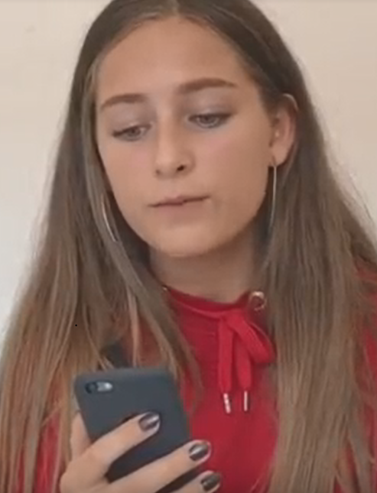
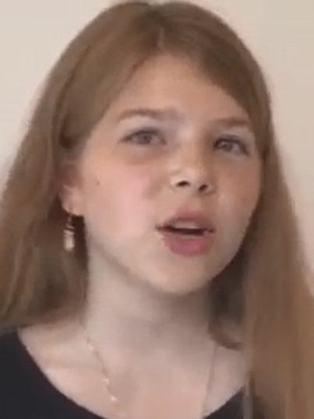
Girls talking about the traffic light tool

Slide 13
Examples of added values that the use of digital technology can provide
Increase the deeper understanding of maths and the use of it
Move the teaching away from the “how to” and more towards the “why”
Improve students’ activity
Discover misconceptions or lack of understanding of the students
Take maths out of the classroom, or take real life into the classroom, because realistic materials can be handled more easily with digital tools
Spend more time facilitating the student’s learning instead of instructing
Use exploration in the teaching to increase understanding and minimize ”robot-learning”

Slide 14
Guidance: Examples of ”green” use of technology
Differentiation
Visualization
Learning by dialogue
Increase the understanding of numbers, place value, when to use which of the 4 operations (addition, subtraction, multiplication and division and the commutative property)
Making teaching take off from what the students already know
Collaborative learning
Train mathematical precision, e.g. formulas in spread-sheets
Processing large data volumes, e.g. in statistics
Speed up operations that are already understood
Motivation, as an icebreaker for students who find maths dull and difficult
Increase creativity

Slide 15
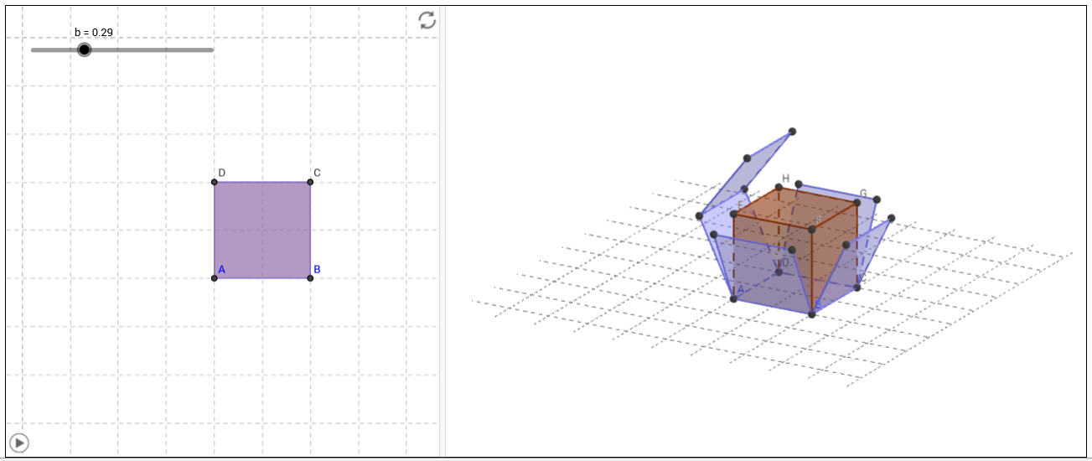
Example: Visualization
Finding the surface of a cube

Slide 16
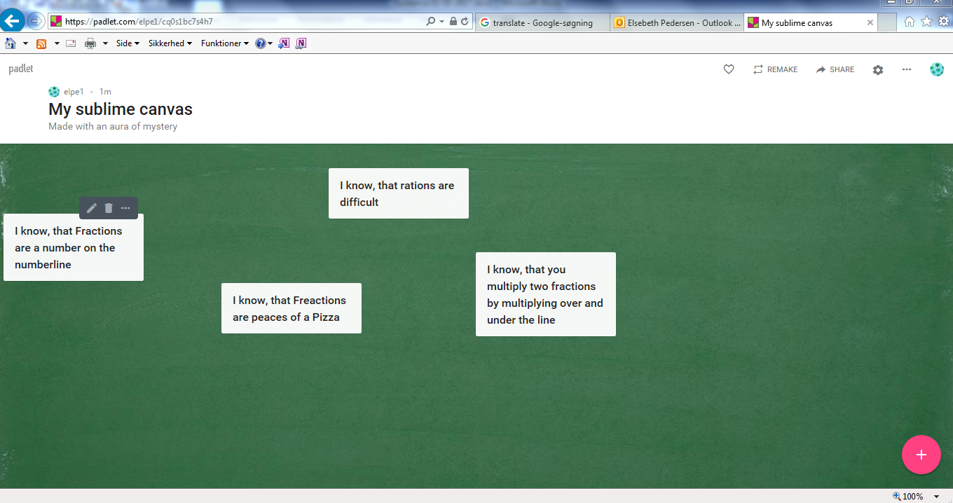
Making teaching take off from what the students already know
Questions for the students: What do you know about fractions?

