Slide 2
Welcome
With the support of
the Erasmus+ programme
of the European Union
Welcome to the launch of DigiMaths!
Also known as Maximising the opportunities of digital technologies to teach numeracy
Funded by Erasmus+
We are pleased to broadcast our launch through Facebook Live

Slide 3
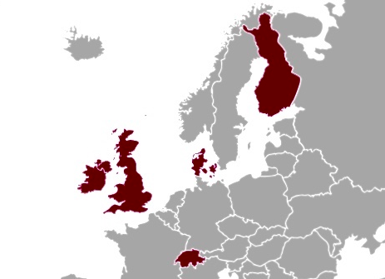

Slide 4
Our focus:
the effective use of digital technologies in the teaching of numeracy/mathematics in all sectors and for all ages

Slide 5
Our aim:
to equip educators with the tools they can use to make judgements for themselves about ways in which digital technologies can add value to learning and teaching

Slide 6
Definitions
Numeracy and mathematics
Numeracy is ‘the ability to access, use, interpret and communicate mathematical information and ideas, in order to engage in and manage the mathematical demands of a range of situations in adult life’.
Digital technologies
Electronic systems such as online platforms, games, application software, multimedia, cloud computing, online networks, social media, programming tools electronic devices such as computers, laptops, tablets, smart phones and other mobile devices, smartboards/ watches, digital recording equipment digital means of finding, analysing, creating and communicating information in a digital setting.
Levels
The DigiMaths project has focused on numeracy/mathematics learning at teaching at levels up to European Qualification Framework level 4.

Slide 7
Literature Review
Our review of literature has examined the benefits of integrating technology in the mathematics classroom.
The barriers to integration were also investigated along with how they may be overcome.
Finally the literature has reviewed the current technological landscape of a number countries involved in this Erasmus + research.

Slide 8
DigiMaths Survey
A survey of teachers in Europe relating to their use of digital technologies to teach mathematics/numeracy in a variety of settings.
The survey was designed to produce data that, along with the literature review, will directly inform the development of the guidance, the training course and the resources that support the training course.

Slide 9
Overview
In our research we found the Substitution Augmentation Modification Redefinition Model (SAMR Model) a useful tool for thinking about how we use digital technologies for teaching.
The SAMR Model offers a method of seeing how digital technology might impact teaching and learning.

Slide 10
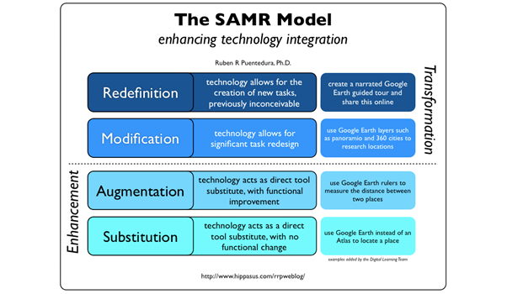
The SAMR model was developed by Dr. Ruben Puentedura http://www.hippasus.com/

Slide 11
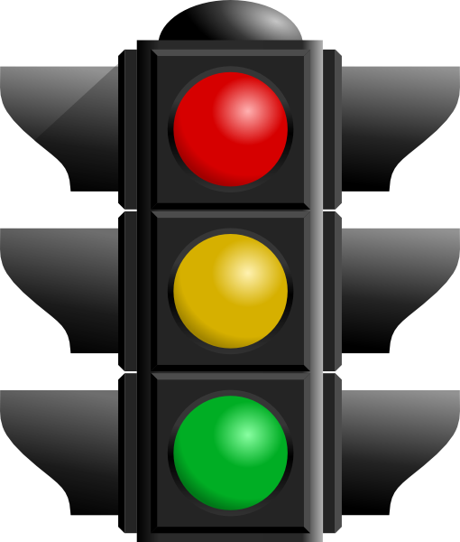

Slide 12
Red — detracts from the maths learning
e.g.) software that crunches the numbers or creates graphs from equations for you
Amber— adds nothing
e.g.) filling in worksheets on Microsoft Word instead of using a pen and paper
Green — adds value
e.g.) software that enables learners to “manipulate” complex shapes on a tablet to help the understand the features

Slide 13
The Learning Outcome
The DigiMaths project draws on our research and guides teachers to make good decisions about the sorts of digital technology they chose, how to use it and in what ways it improves the students’ learning.

